Slide 1
Data Science Bootcamp –
SVM – Support Vector Machine
Naïve Bayes Algorithm
Shovon Sengupta

Slide 2



Support Vector Machine- Explained
Overview – SVM
A support vector machine (SVM) can be imagined as a surface that maximizes the boundaries between various types of points of data that is represent in multidimensional space, also known as a hyperplane, which creates the most homogeneous points in each sub-region. Support vector machines can be used on any type of data, but have special extra advantages for data types with very high dimensions relative to the observations, for example:
Text classification, in which language has the very dimensions of word vectors
For the quality control of DNA sequencing by labeling chromatograms correctly
Support Vector machines – Working Principles :
Support vector machines are mainly classified into three types based on their working principles:
Maximum Margin Classifier
Support Vector Classifier
Support Vector Machine
Maximum Margin Classifier - People usually generalize support vector machines with maximum margin classifiers. However, there is much more to present in SVMs compared to maximum margin classifiers, which we will be covering in this chapter. It is feasible to draw infinite hyperplanes to
classify the same set of data upon, but the million dollar question, is which one to consider as an ideal hyperplane? The maximum margin classifier provides an answer to that: the hyperplane with the maximum margin of separation width.
Hyperplanes: Before going forward, let us quickly review what a hyperplane is. In n-dimensional space, a hyperplane is a flat affine subspace of dimension n-1. This means, in 2- dimensional space, the hyperplane is a straight line which separates the 2-dimensional space into two halves. The hyperplane is defined by the following equation:
Points which lay on the hyperplane have to follow the above equation. However, there are regions above and below as well. This means observations could fall in either of the regions, also called the region of classes:
Notes:
Mercer’s Theorem:
According to Mercer’s theorem, if a function K(a, b) respects a few mathematical conditions called Mercer’s conditions (K must be continuous, symmetric in its arguments so K(a, b) = K(b, a), etc.), then there exists a function ϕ that maps a and b into another space (possibly with much higher dimensions) such that K(a, b) = ϕ(a)T ・ϕ(b). So you can use K as a kernel since you know ϕ exists, even if you don’t know what ϕ is. In the case of the Gaussian RBF kernel, it can be shown that ϕ actually maps each training instance to an infinite-dimensional space, so it’s a good thing you don’t need to actually perform the mapping! Note that some frequently used kernels (such as the Sigmoid kernel) don’t respect all of Mercer’s conditions, yet they generally work well in practice.

Slide 3

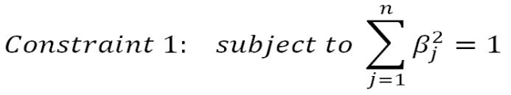

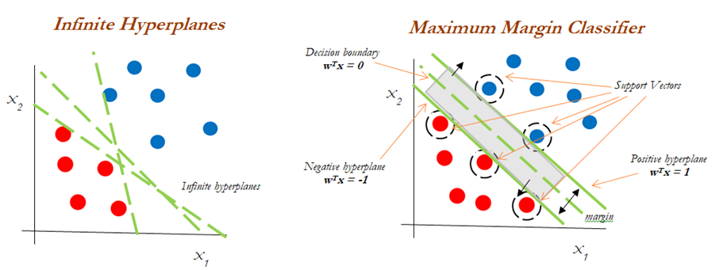
Support Vector Machine- Contd.
Overview – SVM
The mathematical representation of the maximum margin classifier is as follows, which is an optimization problem:
Constraint 2 ensures that observations will be on the correct side of the hyperplane by taking the product of coefficients with x variables and finally, with a class variable indicator.
In non-separable cases, the maximum margin classifier will not have a separating hyperplane, which is also known as no feasible solution. This issue will be solved with support vector classifiers, which we will be covering in the next section.
In the following diagram, we can draw infinite separate hyperplanes to separate the two classes (blue and red). However, the maximum margin classifier attempts to fit the widest slab (maximize the margin between positive and negative hyperplanes) between two classes and the observations touching both the positive and negative hyperplanes called support vectors:
Classifier performance purely depends on the support vectors and any changes to observation values which are not support vectors (or observations that do not touch hyperplanes) do not impact any change in the performance of the Maximum Margin Classifier, as only extreme points are considered in the algorithm.
Notes:
A Note on Hinge Loss –
The function max(0, 1 – t) is called the hinge loss function (represented below). It is equal to 0 when t ≥ 1. Its derivative (slope) is equal to –1 if t < 1 and 0 if t > 1. It is not differentiable at t = 1, but just like for Lasso Regression you can still use Gradient Descent using any subderivative at t = 0 (i.e., any value between –1 and 0).

Slide 4

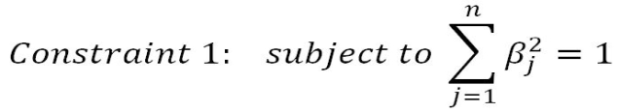
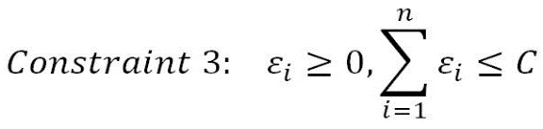
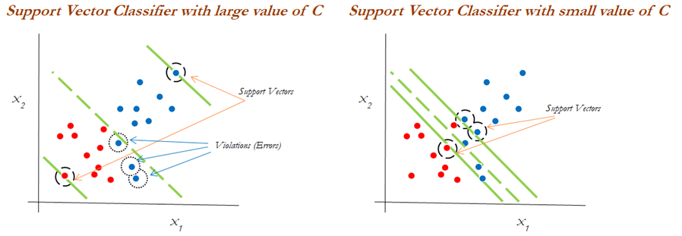
Support Vector Machine- Contd.
Overview – SVM
Support Vector Classifier –
Support vector classifiers are an extended version of maximum margin classifiers, in which some violations are tolerated for non-separable cases in order to create the best fit, even with slight errors within the threshold limit. In fact, in real-life scenarios, we hardly find any data with purely separable classes; most classes have a few or more observations in overlapping classes. The mathematical representation of the support vector classifier is as follows, a slight correction to the constraints to accommodate error terms:
In constraint 3, the C value is a non-negative tuning parameter to either accommodate more or fewer overall errors in the model. Having a high value of C will lead to a more robust model, whereas a lower value creates the flexible model due to less violation of error terms. In practice the C value would be a tuning parameter as is usual with all machine learning models.
The impact of changing the C value on margins is shown in the diagram; with the high value of C, the model would be more tolerating and also have space for violations (errors) in the left diagram, whereas with the lower value of C, no scope for accepting violations leads to a reduction in margin width. C is a tuning parameter in Support Vector Classifiers:

Slide 5
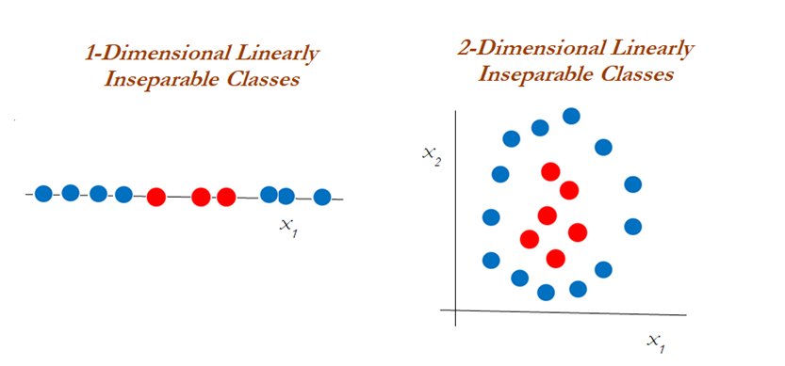
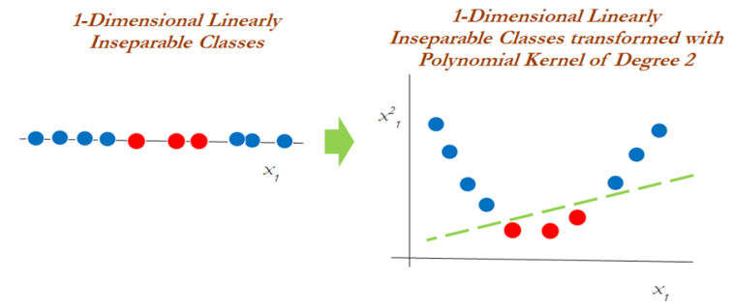
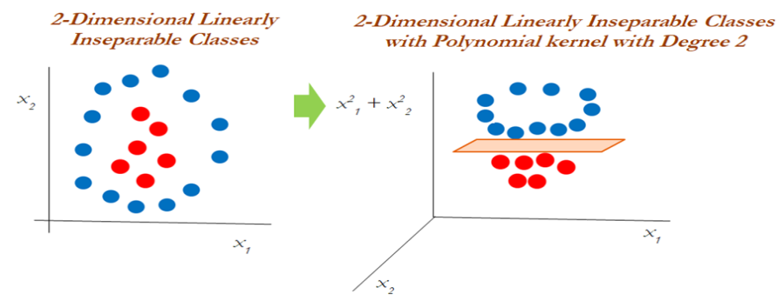
Support Vector Machine- Contd.
Overview – SVM
Support Vector Machines –
Support vector machines are used when the decision boundary is non-linear and would not be separable with support vector classifiers whatever the cost function is! The following diagram explains the non-linearly separable cases for both 1-dimension and 2-dimensions:
It is apparent that we cannot classify using support vector classifiers whatever the cost value is. Hence, we need to use another way of handling the data, called the kernel trick, using the kernel function to work with non-linearly separable data. In the following diagram, a polynomial kernel with degree 2 has been applied in transforming the data from 1-dimensional to 2-dimensional data. By doing so, the data becomes linearly separable in higher dimensions. In the left diagram, different classes (red and blue) are plotted on X1 only, whereas after applying degree 2, we now have 2-
dimensions, X1 and X² ₁ (the original and a new dimension). The degree of the polynomial kernel is a tuning parameter; the practitioner needs to tune them with various values to check where higher accuracies are possible with the model; Whereas, in the 2-dimensional case, the kernel trick is applied as below with the polynomial kernel with degree 2. It seems that observations have been classified successfully using a linear plane after projecting the data into higher dimensions:

Slide 6


Support Vector Machine- Contd.
Overview – Kernel Function
Kernel Functions –
Kernel functions are the functions that, given the original feature vectors, return the same value as the dot product of its corresponding mapped feature vectors. Kernel functions do not explicitly map the feature vectors to a higher-dimensional space, or calculate the dot product of the mapped vectors. Kernels produce the same value through a different series a of operations that can often be computed more efficiently. The main reason for using kernel functions is to eliminate the computational requirement to derive the higher-dimensional vector space from the given basic vector space, so that observations be separated linearly in higher dimensions. Why someone needs to like this is, derived vector space will grow exponentially with the increase in dimensions and it will become almost too difficult to continue computation, even when you have a variable size of 30 or so. The following example shows how the size of the variables grows. Example: When we have two variables such as x and y, with a polynomial degree kernel, it needs to compute x², y², and (x.y) dimensions in addition. Whereas, if we have three variables x, y, and z, then we need to calculate the x², y², z², (x.y), (y.z), (x.z), and (x.y.z) vector spaces. You will have realized by this time that the increase of one more dimension creates so many combinations. Hence, care needs to be taken to reduce its computational complexity; this is where kernels do wonders. Kernels are defined more formally in the following equation:
Polynomial Kernel –
Polynomial kernels are popularly used, especially with degree 2. In fact, the inventor of support vector machines, Vladimir N Vapnik, developed using a degree 2 kernel for classifying handwritten digits. Polynomial kernels are given by the following equation:
Radial Basis Function/ Gaussian Kernel (RBF) –
RBF kernels are a good first choice for problems requiring nonlinear models. A decision boundary that is a hyperplane in the mapped feature space is similar to a decision boundary that is a hypersphere in the original space. The feature space produced by the Gaussian kernel can have an infinite number of dimensions, a feat that would be impossible otherwise. RBF kernels are represented by the following equation:

Slide 7
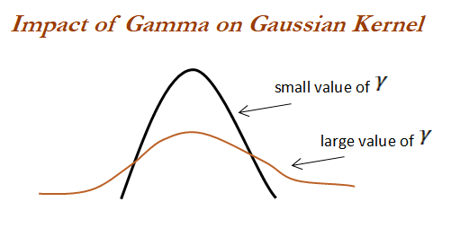
Support Vector Machine- Contd.
Overview – Kernel Function Contd.
It is advisable to scale the features when using support vector machines, but it is very important when using the RBF kernel. When the value of the gamma value is small, it gives you a pointed bump in the higher dimensions; a larger value gives you a softer, broader bump. A small gamma will give you low bias and high variance solutions; on the other hand, a high gamma will give you high bias and low variance solutions and that is how you control the fit of the model using RBF kernels:

Slide 8
Support Vector Machine- Contd.
Types SVM models – In R
SVM - Classification | SVM -Regression
Binary response classification using C-SVM (svmpath) | SVM eps-Regression (svm)
Multi-category classification using C-SVM (svm) | SVM nu-Regression (svm)
Multi-category classification using nu-SVM (svm) | Bound – Constraint SVM eps-Regression (ksvm)
Bound-Constraint C-SVM Classification (ksvm) | *Novelty Detection – One Class SVM (svm)
West on – Watkins Multi-Class SVM (ksvm) | **Relevance Vector Machine (rvm)
Crammer - Singer Multi-Class SVM (ksvm) | RVM Regression (rvm)
Some Practical Applications – SVM :
Classification of Dengue Fever Patient.
Forecasting Stock Market Direction.
Bankruptcy Prediction
Flood Susceptibility.
Spam Detection
Signature Authentication
Prediction of Vitamin D Status
Notes:
* This method is primarily used for outlier detection.
** Not Exactly a Regression method though – It exploits probabilistic Bayesian learning framework

Slide 9
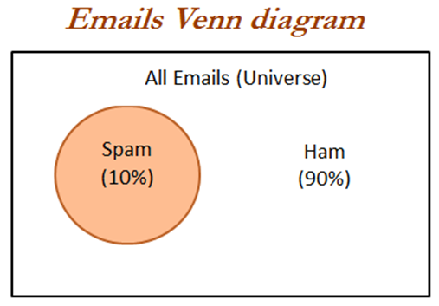
Naïve Bayes Algorithm- Explained
Overview – Naïve Bayes
Bayes algorithm concept is quite old and exists from the 18th century since Thomas Bayes. Bayes developed the foundational mathematical principles for determining the probability of unknown events from the known events. For example, if all apples are red in color and average diameter would be about 4 inches then, if at random one fruit is selected from the basket with red color and diameter of 3.7 inch, what is the probability that the
particular fruit would be an apple? Naive term does assume independence of particular features in a class with respect to others. In this case, there would be no dependency between color and diameter. This independence assumption makes the Naive Bayes classifier most effective in terms of computational ease for particular tasks such as email classification based on words in which high dimensions of vocab do exist, even after
assuming independence between features. Naive Bayes classifier performs surprisingly really well in practical applications.
Bayesian classifiers are best applied to problems in which information from a very high number of attributes should be considered simultaneously to estimate the probability of final outcome. Bayesian methods utilize all available evidence to consider for prediction even features have weak effects on the final outcome to predict. However, we should not ignore the fact that a large number of features with relatively minor effects, taken together its combined impact would form strong classifiers.
Probability Fundamentals:
Before diving into Naive Bayes, it would be good to reiterate the fundamentals. Probability of an event can be estimated from observed data by dividing the number of trails in which an event occurred with total number of trails. For instance, if a bag contains red and blue balls and randomly picked 10 balls one by one with replacement and out of 10, 3 red balls appeared in trails we can say that probability of red is 0.3, pred = 3/10 = 0.3. Total probability of all possible outcomes must be 100 percent. If a trail has two outcomes such as email classification either it is spam or ham and both cannot occur simultaneously, these events are considered as mutually exclusive with each other. In addition, if those outcomes cover all possible events, it would be called as exhaustive events. For example, in email classification if P (spam) = 0.1, we will be able to calculate P (ham) = 1- 0.1 = 0.9, these two events are mutually exclusive. In the Venn diagram, all the email possible classes are represented (the entire universe) with type of outcomes:

Slide 10
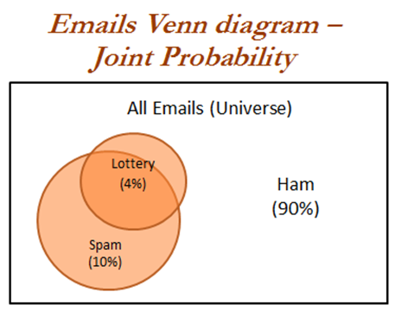
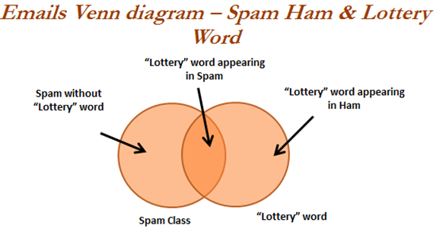
Probability - Explained
Overview – Joint Probability
Though mutually exclusive cases are simple to work upon, most of the actual problems do fall under the category of non-mutually exclusive events. By using the joint appearance, we can predict the event outcome. For example, if emails messages present the word like lottery, which is very highly likely of being spam rather than ham. The following Venn diagram indicates the joint probability of spam with lottery. However, if you notice in detail, lottery circle is not contained completely within the spam circle. This implies that not all spam messages contain the word lottery and not every email with the word lottery is spam.
We have seen that 10 percent of all the emails are spam and 4 percent of emails have the word lottery and our task is to quantify the degree of overlap between these two proportions. In other words, we need to identify the joint probability of both p(spam) and p(lottery) occurring, which can be written as p(spam ∩ lottery). In case if both the events are totally unrelated, they are called independent events and their respective value is p(spam ∩lottery) = p(spam) * p(lottery) = 0.1 * 0.04 = 0.004, which is 0.4 percent of all messages are spam containing the word Lottery. In general, for independent events P(A∩ B) = P(A) * P(B).

Slide 11

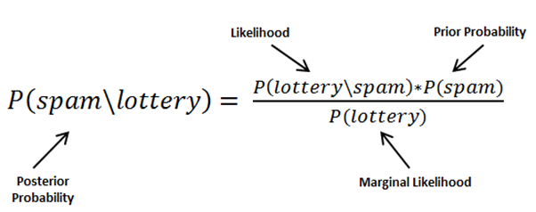
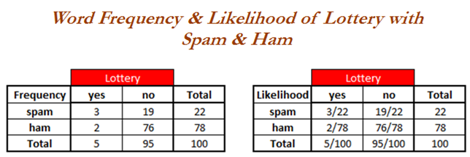
Bayes Theorem - Explained
Overview – Conditional Probability
Understanding Bayes Theorem with Conditional Probability:
Conditional probability provides a way of calculating relationships between dependent events using Bayes theorem. For example, A and B are two events and we would like to calculate P(A\B) can be read as the probability of event occurring A given the fact that event B already occurred, in fact this is known as conditional probability, the equation can be written as follows:
To understand better, we will now talk about the email classification example. Our objective is to predict whether email is spam given the word lottery and some other clues. In this case we already knew the overall probability of spam, which is 10 percent also known as prior probability. Now suppose you have obtained an additional piece of information that probability of word lottery in all messages, which is 4 percent, also known as marginal likelihood. Now, we know the probability that lottery was used in previous spam messages and is called the likelihood.
By applying the Bayes theorem to the evidence, we can calculate the posterior probability that calculates the probability that the message is how likely being a spam; given the fact that lottery was appearing in message. On average if the probability is greater than 50 percent it indicates that the message is spam rather than ham.
In the previous table, the sample frequency table that records the number of times Lottery appeared in spam and ham messages and its respective likelihood has been shown. Likelihood table reveals that P(Lottery\Spam)= 3/22 = 0.13, indicating that probability is 13 percent that a spam message contains the term Lottery. Subsequently we can calculate the P(Spam ∩ Lottery) = P(Lottery\Spam) * P(Spam) = (3/22) * (22/100) = 0.03. In order to calculate
the posterior probability, we divide P(Spam ∩ Lottery) with P(Lottery), which means (3/22)*(22/100) / (5/100) = 0.60. Therefore, the probability is 60 percent that a message is spam, given that message contains the word Lottery. Hence, don't believe in quick fortune guys!

Slide 12
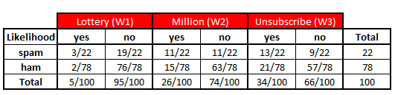
Naïve Bayes Classification- Explained
Overview – Naïve Bayes Classification
Classification – Naïve Bayes:
In the past example, we have seen with single word called lottery, however, in this case we will be discussing with a few more additional words such as Million and Unsubscribe to show how actual classifiers do work. Let us construct the likelihood table for the appearance of the three words (W1, W2, and W3), as shown in the following table for 100 emails:
When a new message is received, the posterior probability will be calculated to determine that email message is spam or ham. Let us assume that we have an email with terms Lottery and Unsubscribe, but it does not have word Million in it, with this details, what is the probability of spam? By using Bayes theorem, we can define the problem as Lottery = Yes, Million = No and Unsubscribe = Yes:
Solving the preceding equations will have high computational complexity due to the dependency of words with each other. As more number of words are added, this will even explode and also huge memory will be needed for processing all possible intersecting events. This finally leads to intuitive turnaround with independence of words (cross-conditional independence) for which it got name of the Naive prefix for Bayes classifier. When both events are independent we can write P(A ∩ B) = P(A) * P(B). In fact, this equivalence is much easier to compute with less memory requirement:

Slide 13
Naïve Bayes Classification- Contd.
Overview – Naïve Bayes Classification
In a similar way, we will calculate the probability for ham messages as well, as follows:
By substituting the preceding likelihood table in the equations, due to the ratio of spam/ham we can just simply ignore the denominator terms in both the equations. Overall likelihood of spam is:
After calculating ratio, 0.008864/0.004349 = 2.03, which means that this message is two times more likely to be spam than ham. But we can calculate the probabilities as follows:
P(Spam) = 0.008864/(0.008864+0.004349) = 0.67
P(Ham) = 0.004349/(0.008864+0.004349) = 0.33
By converting likelihood values into probabilities, we can show in a presentable way for either to set-off some thresholds, and so on.
Laplace Estimator :
In the previous calculation, all the values are non-zeros, which makes calculations easy. Whereas in practice some words never appear in past for specific category and suddenly appear at later stages, which makes entire calculations as zeros. For example, in the previous equation W3 did have a 0 value instead of 13, and it will convert entire equations to 0 altogether:
In order to avoid this situation, Laplace estimator essentially adds a small number to each of the counts in the frequency table, which ensures that each feature has a nonzero probability of occurring with each class. Usually Laplace estimator is set to 1, which ensures that each class-feature combination is found in the data at least once:
Notes:
If you observe the equation carefully, value 1 is added to all three words in numerator and at the same time three has been added to all denominators to provide equivalence.

